Slide 1
AutoParts.com Group 1 Project Dashboard
Presented by:
James Chen
Nisha Rajesh
Shweta Sahalot
Date: November 27th, 2020

Slide 2

Goal: Develop an online marketplace to buy automobile parts via a desktop and mobile-friendly website to meet the business objectives of Dallas AutoParts LLC.
Desired Solutions will gather the requirements, analyze, design, develop, test, deploy, and deliver the online auto parts marketplace according to the stakeholders’ requirements.
This platform will be easily operated, bilateral, appealing. It will meet the marketing requirements of Dallas Auto Parts LLC and will be available via any web browser.
+
Dallas AutoParts LLC

Slide 3



Team Profile Page
James N. Chen
Huangshan, China
Software Engineering
None
Has a cute cat
Shweta Rakesh Sahalot
Mumbai, Maharashtra,
India
Data Science
QA Analyst Intern
Loves dancing and travelling
Nisha Rajesh
Plano, TX
Full Stack Development
Software Engineering Intern
Plays the viola
Notes:
Individual Picture of each member
Hometown (city, state)
Primary focus area or desired focus area
Current internship position or job position (company is not needed)
One interesting fun fact about the person

Slide 4
AutoParts.com
Project Status is Green:
Summary Project Status Financial Status
Desired Solutions will develop an online marketplace for automobile parts in a collaborative environment to meet the business objectives of Dallas Auto Parts LLC. This platform will be easily operated, bilateral, appealing. It will meet the marketing requirements of Dallas Auto Parts LLC and will be available via any web browser.
The project is currently proceeding as scheduled and within budget. We have started the resolution process to remain on schedule. The team has completed the development phase and has moved into the testing phase.
Total Contract Value: $462,480.00
CR’s To-Date: $78,960.00
Total Contract Value: $462,480.00 (Margin: $74,200.00)
Budget (Baseline + CR’s):
Actual Spent: $341,034.00
ETC: $47,246.00
EAC: $388,280.00
Current Margin: $74,200.00
Key Achievements
Planned Activities
Risks / Issues
Major Milestones
Interview the customer to gather project requirements. (July 1st, 2020)
Review and finalize requirements for each project phase (July 30th, 2020)
Select project server platform, framework, and architecture (August 7th, 2020)
Finalize design plans for the front-end, back-end, and database-side of the project. (September 10th, 2020)
Set up the website server (September 18th, 2020)
Complete server testing
(Sep 25th , 2020)
Complete database testing
(Oct 6th, 2020)
Complete back-end testing
(Oct 30th, 2020)
Finished Project Development
(Nov 10th, 2020)
Complete Front-end testing Dec 17th, 2020
Perform end-to-end testing (Dec 29th ,2020)
Perform defect test case fixing (Jan 8th , 2020)
Deploy website (Jan 15th, 2021)
Get Customer review and sign-off (Jan 19th, 2021)
Perform Project Hand-off (Jan 20th, 2021)
Complete Client training (Jan 25th, 2021)
Collect final Project pay-off (Jan 25th, 2021)
Perform project audit and draft lessons learned document (Feb 10th, 2021)
RISK: The end-to-end testing may not complete as per schedule due to lack of code coverage for front-end
MITIGATION 1) Testing team should create more test cases in order to give a better code coverage
MITIGATION 2) Perform partial end-to-end testing before schedule
RISK:When deploying the website, the server might crash, delaying our scheduled deployment time.
. MITIGATION:1) Daily measurement of network requirement before deployment
MITIGATION 2) Set up a backup server to prevent server issue
Business Process Complete June 25th, 2020
Requirements Phase Closed July 30th, 2020
Design Phase Closed September 10th, 2020
Development Phase Closed November 10th, 2020
Testing Phase (In Progress)
January 13th , 2021
Deployment Phase (In Progress)
January 20th , 2021
Closing Phase (In Progress)
January 25th , 2021
Notes:
7/21/20202011-10-19
‹#›
CRICKET_HOUSTON_CDMA_LTE_MEETING
‹#›
‹#›
CDMA_LTE_STEERING_MEETING
2012-06-13

Slide 5
Major Milestones - Tracking
Critical Path / Key Milestones & Activities
Milestone | Status | % Done | Planned Start | Actual Start | Planned Finish | Actual Finish | Comments
Business Processes Complete | C | 100% | June 19th, 2020 | June 19th, 2020 | June 25th, 2020 | June 25th, 2020 | Phase completed without any setbacks
Requirements Phase Closed | C | 100% | July 7th, 2020 | July 7th, 2020 | July 30th, 2020 | July 30th, 2020 | Requirements phase completed on time with no risks
Design Phase Closed | C | 100% | August 3rd, 2020 | August 3rd, 2020 | September 10th, 2020 | September 10th, 2020 | Design Phase has been completed and no risks were encountered
Development Phase Closed | C | 100% | September 11th, 2020 | September 11th, 2020 | November 10th, 2020 | November 10th, 2020 | Development phase closed without issues
Testing Phase Closed | G | 61% | September 21st, 2020 | September 21st, 2020 | January 13th, 2021 | TBD | In progress, faced a minor issue which has been resolved.
Deployment Phase Closed | G | 0% | January 14th, 2020 | TBD | January 20th, 2021 | TBD
Project Closing Processes Complete | G | 0% | January 20th, 2020 | TBD | January 22nd, 2021 | TBD

Slide 6
AUTOPARTS.COM – timeline
Requirement Phase
Design Phase
Development phase
Testing phase
Deployment Phase
Jul 30
Sep 10
Nov 10
Today
Jan 13
Nov 20
2020
06/19
07/10
07/31
08/21
09/11
10/02
10/23
11/13
01/04
01/22
2021
Jun 19
Jan 22
Business Process
Project closing processes
Business Process
June 19 - June 19
Requirement Phase
Jul 1 - Jul 30
Design Phase
Aug 3 - Sep 10
Development phase
Sep 11 - Nov 10
Testing phase
Nov 9 - Jan 13
Deployment Phase
Jan 14 - Jan 20
Project closing processes
Jan 20 - Jan 22

Slide 7
Program Risks/Issues
Item # | Issue/Risk | Description | Resolution Plan / Mitigation Plan | Contingency Plan | Due Date | Owner
R-7 | Risk | COVID-19 causes budget cuts & project shortages in client organization, which may cause a shutdown of the project. | 1) Set up meeting with client to discuss project milestone payments | 1) Close the project | Payment collection day | Project Manager
R-3 | Risk | Defect fixing task may take longer than expected because of insufficient code coverage, which will delay the testing phase schedule. | 1) Perform defect testing earlier on in the schedule 2) Monitor the development process frequently to prevent defect situations | 1) Formulate a defect fixing plan | 30-Nov | Shweta
R-6 | Risk | When deploying the website, the server might crash, delaying our scheduled deployment time. | 1) Daily measurement of network requirement before deployment 2) Set up a backup server to prevent server issue | 1) Set up a backup server to prevent server issue 2) Take precautionary measures for network failures | 24-Nov | Nisha
R-8 | Risk | The testing progress for user profile history function and auto parts info list function may not be finish on time, since the implementation of these two function took longer. | 1) Tester 1 have slack at this moments, he can join in and help pushing the progress | 1) Keep track of testing and hire experts to solve this issue | 6-Oct | Testing Lead
R-9 | Risk | As a result of COVID-19, all employees are forced to work from home, which may lead to meetings taking longer than before. Each employee may have different network speed, using VPN and VM is slower than usual, which may reduce the efficiency | 1) Using a good video conferencing software to improve working efficiency 2) Train IT department to fix the network issue. | 1) Mandate weekend work to remain on schedule 2) Have frequent conference meetings | ASAP | Project Manager

Slide 8
Key Actions
# | Description | Originator | Owner | Date Assigned | Date Needed | Date Closed | Comments | Status
A-9 | Set up front-end testing environment to prepare front-end testing process | Project Manager | Testing lead | 2-Oct-20 | 4-Nov-20 |  | Set up early to speed up the testing phase | In progress
A-10 | Set up back-end testing environment to prepare back-end testing process | Project Manager | Testing lead | 2-Oct-20 | 7-Nov-20 |  | Set up early to speed up the testing phase | In progress
A-11 | Set up a demo meeting with design team and developer team for server testing result | Testing lead | Project Manager | 5-Oct-20 | 8-Oct-20 |  | Make sure all testing procedure are following the design and requirements | In progress
A-12 | Tester 1 should collaborate with tester 2 on database function test | Testing lead | Tester 1 | 2-Oct-20 | 6-Oct-20 |  | The project is behind of schedule, need to push the progress | In progress
A-13 | Deployment team should monitor the website admin and server admin connection qualities | Project Manager | Deployment Lead | 5-Oct-20 | 1/1/2021 |  | Make sure when deploy the website, the server and website admin are working functional | In progress
A-14 | We finished 50% project on time, give project team a day off on Friday 10/9/20 | Project Manager | Project Manager | 5-Oct-20 | 8-Oct-21 |  | To acknowledge and appreciate all the efforts the team has put into the project
A-15 | Testing team, design team and development team and deployment team leaders should have a meeting to go over the entire project. | Project Manager | Project Manager, all team leads | 2-Oct-20 | 8-Jan-21 |  | To ensure that deployment is 100% successful.

Slide 9
Key Decisions
# | Description | Owner | Date | Comments
D-1 | Project decide to meet every day 9:30 am to monitor the project progress | PM | 30-Jun-20 | Everyone is WFH, should keep track of project schedule
D-2 | Design team decide to use AWS as the server | Design team leader | 03-Aug-20 | Use AWS as server platform
D-3 | Decide to have monthly meeting with the leadership to report project progress | PM | 03-Jul-20 | Leader team wants to know the project progress
D-4 | Deployment team leader decide to have stand up meeting everyone with development meeting to exchange information | Deployment Lead | 03-Jul-20 | Keep each team on the same page
D-5 | Testing Team lead decides to use tester 2 (TEST2) for database testing | Testing Team Lead | 29-Sep-20 | Tester 2 is needed to complete testing on time.
D-6 | We decided to setup a backup framework to support hosting the application, in case the main server is down | Deployment Lead | 02-Oct-20 | To ensure that deployment is successful

Slide 10
Project Management Plan Documents

Slide 11
Statement of Work

Slide 12
Statement of Work (SOW)
Key components:
Front End (user interface & design)
Back End (product search, user account creation/interaction)
Database (product data storage)
Occupation | Hourly Rate
Project Manager | $90.00 / hr
Design Engineer | $90.00 / hr
Developer | $60.00 / hr
Test Engineer | $50.00 / hr
Deployment Engineer | $50.00 / hr
Requirements Engineer | $70.00 / hr
Accountant | $30.00 / hr
Milestones | Description | Cost
M00 | Project-wide Project Management | $319,104
M01 | Requirements Phase | $16,416
M02 | Design Phase | $25,344
M03 | Development Phase | $50,400
M04 | Testing Phase | $49,008
M05 | Deployment Phase | $2,208
Total |  | $462,480

Slide 13
Work Breakdown Structure

Slide 14
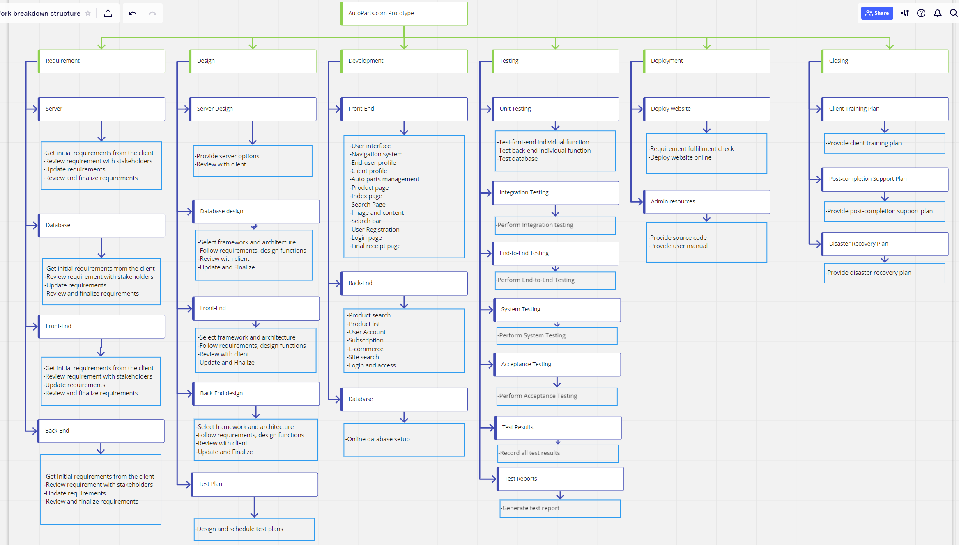
https://miro.com/welcomeonboard/oNTChmXBZ4XEjUy1DTsiPPSysnVZBKAO8ffojktVzJgL3lPWvx7aIJSzGa1dZC4L

Slide 15
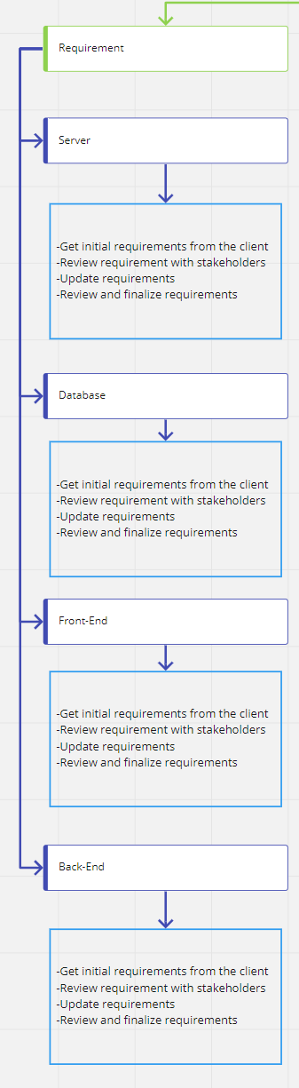
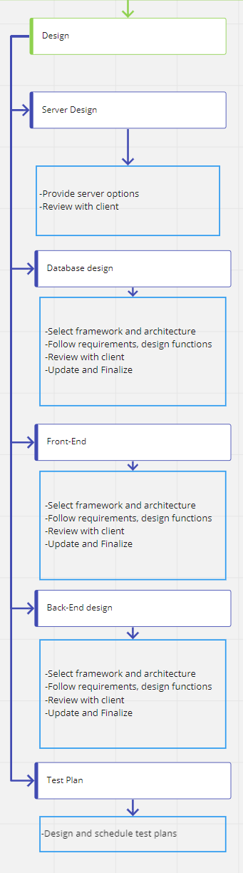
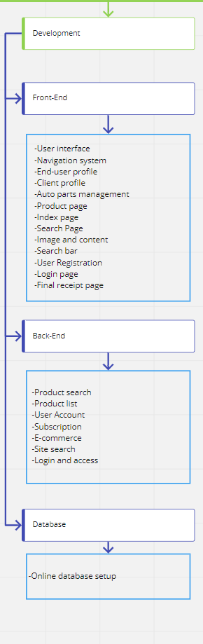
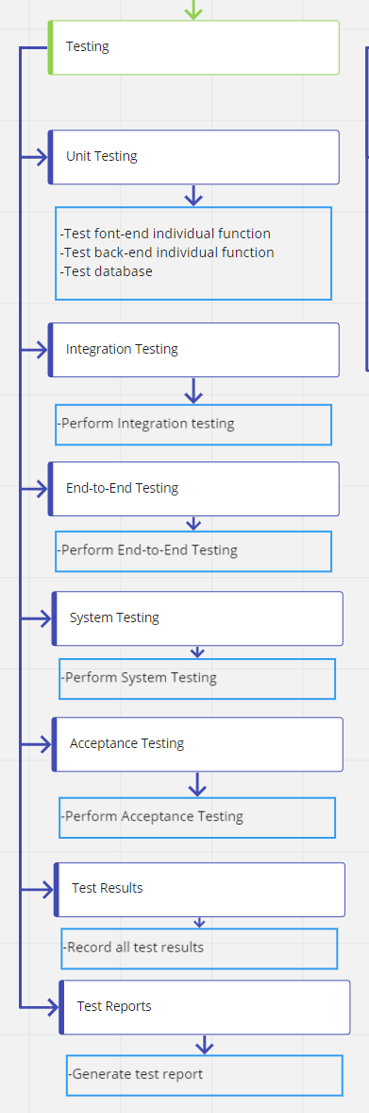

Slide 16
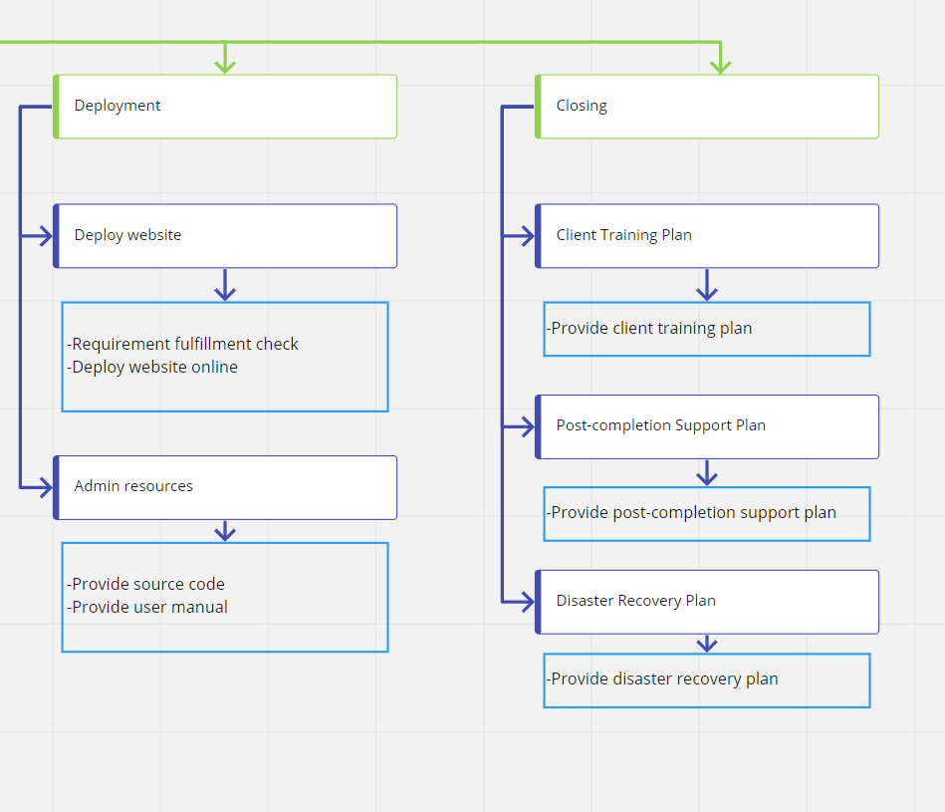

Slide 17
Risk Mangement Plan

Slide 18
A risk is any unexpected event that may or may not have an adverse impact on the project. A risk may affect people, processes, technology, and resources. For instance, currently, corona virus has affected the better part of the world and due to this people are forced to work from home which has led to decrease in productivity in majority of the projects. Other examples could be a key resource leaving the project midway, or a key product component being on backorder.
For determining a risk, we must consider following five elements: risk event (what might happen to affect your project?), risk timeframe (when is it likely to happen?), probability (what’s are the chances of it happening?) impact (what’s the expected outcome?), factors (what events might forewarn or trigger the risk event?). Preparing a risk assessment to get a better understanding of the kinds of risks your project is facing and its possible consequences is the responsibility of the project manager.
Desired Solutions has a risk management plan which is depicted by the flowchart below. We carefully examine each work package to identify the potential risks, analyze them and treat them in advance if necessary. Say for instance if we are aware that a resource (senior developer) in the development team might take leave during the development phase of the project we might train two junior developers well in advance, or we could hire a new senior developer.

Slide 19
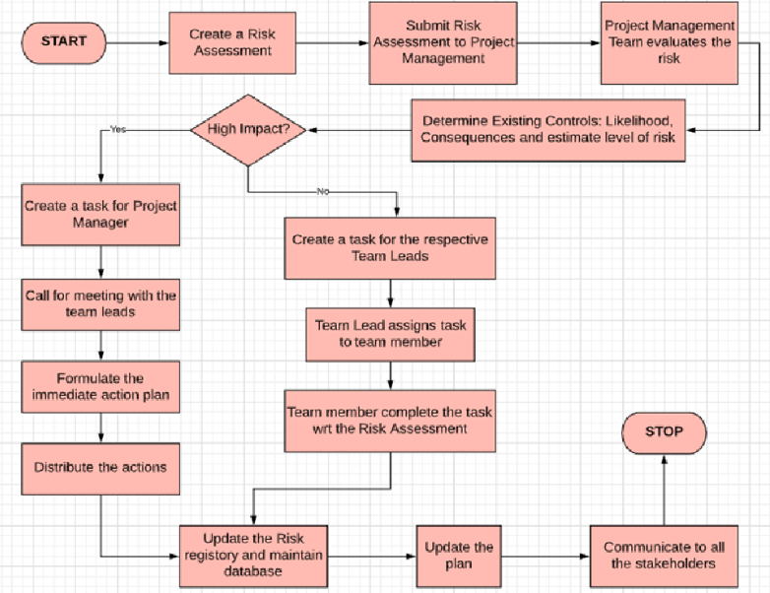

Slide 20
Sr No | Flowchart Element | Description
1 | START | When a risk is identified, the process of Risk Management Plan will start from this point.
2 | Create a Risk Assessment | Any member from different teams in the project can create a risk assessment request. For example, a developer or a tester.
3 | Submit Risk Assessment to Project Management | This risk assessment is then submitted to the project management team to review.
4 | Project Management Team evaluates the risk | The project management team evaluates the risk based on the information provided
5 | Determine Existing Controls: Likelihood, Consequences and estimate level of risk | Risk likelihood and its consequences should be calculated in order to estimate the level of risk. Risk are categorized as high level and low level.
6 | High Impact? | This classifies the flow based on the level of risk
7 | Create a task for Project Manager | If it is a high-level risk, it is escalated to the project manager and a task is generated for him to investigate the risk
8 | Call for meeting with the team leads | The project manager will conduct a meeting with the team leads to formulate the mitigation or contingency plan
9 | Formulate the immediate action plan | The team leads and project manager develop the action plan that includes steps needed to overcome the risk
10 | Distribute the actions | Communication is sent to all the stakeholders about the change being implemented.
11 | Create a task for the respective Team Leads | If the risk not high level, a task for assigned to individual team leads
12 | Team Lead assigns task to team member | Team leads assign the task of formulating the mitigation plan to individual team members
13 | Team member complete the task wrt the Risk Assessment | Assigned Team member performs the task and closes the task.
14 | Update the Risk registry and maintain database | Risk registry is updated with the identified risk for future projects and database is maintained.
15 | Update the plan | Updates to the project schedule or plan are made to incorporate our risk mitigation plan.
16 | Communicate to all the stakeholders | Communication is sent to all the stakeholders about the change being implemented.
17 | STOP | This Risk Management Process has finished.

Slide 21
Change Management Plan

Slide 22
A change may occur at any point during the project. For instance, a change in the requirement, a change in the design or interface. Such changes need to be managed in an efficient manner. Change management is the process, tools and techniques used to manage changes to achieve the required business outcome. Change management involves steps like Planning the change, managing the change and finally reinforcing the change. The tools that can be used include individual change model, communications, sponsorships, coaching, training.
Desired Solutions has a Change Management Process (managed in ServiceNow Platform) in place to handle changes in any project.
A change request is raised by a team member the CR is currently in Draft state, this change request is then reviewed and modified if needed by the team lead and sent to the Change Management Team. The Change Management Team reviews the CR to see if any more details are needed (if yes, the Change Request Team will not reject and send it back to the team that submitted the Change Request) if not, they approve it. The change management team can also reject the request, in this case the change management process stops. After this approval, the change management team assigns a task to the teams that will be impacted by this change. Each team member completes the task, after which Documents are updated and communication is sent to all the stakeholders.

Slide 23
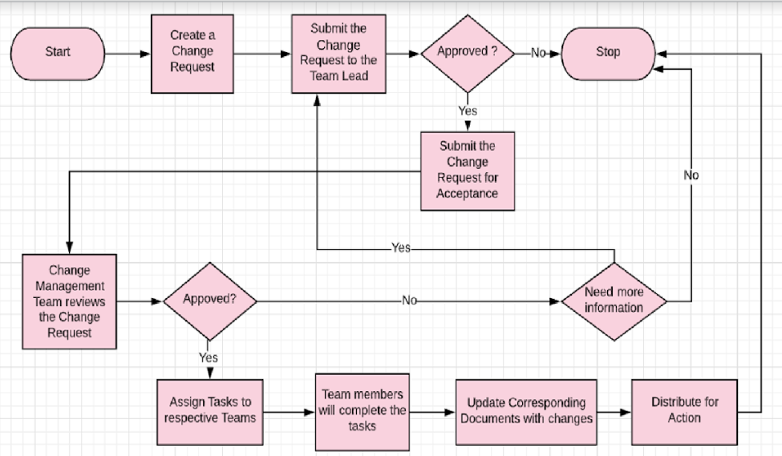

Slide 24
Sr No | Flowchart Element | Description
1 | Start | Whenever a change originates this process of Change Management Plan will start from this point.
2 | Create a Change Request | Any member from different teams in the project can raise a change request. For example, a developer or a tester.
3 | Submit the Change Request to Team Lead | This change request is then submitted to the team lead of that team to review and modify to the change request.
4 | Approved? | The team lead decides whether the change request can be submitted to Change Management team and he can also make changes to the request and approve it and submit it for Acceptance (Change Request is now in Pending Review state). If not, the team lead will reject and change request and the process terminates. Note: If the Change Requestor is Team Lead this step will skip.
5 | Submit the Change Request for Acceptance | The Change Request will now be submitted to the Change Management Team.
6 | Change Management Team Reviews the Change Request | The Change Management Team reviews the change request, they will then decide to approve or reject.
7 | Approved? | If Change Management team does not approve the change request again goes to step Draft state. If they approve Change Request goes to Work in Progress State)
8 | Need more information? | If the change management team rejects the Change Request, the process will stop. If not, the change management team can send the Change request back to the team who submitted the change request for necessary modifications in the Change Request.
9 | Assign Task to respective Team | Based on the change request inputs, task is assigned to respective team
10 | Team members will complete the task | Assigned Team member performs the task and closes the task.
11 | Update corresponding documents with changes | Necessary updates are made to the respective documents.
12 | Distribute the action | Communication is sent to all the stakeholders about the change being implemented.
13 | Stop | The Change Management Process has finished

Slide 25
Stakeholder Plan

Slide 26
Level One: Stakeholders closely involved with the creation of the project
Project Manager: Responsible for managing the activities of the project. He/she must ensure that the project goals are aligned with the organization’s goals, communicate with all the stakeholders to meet their needs and requirements, and ensure the success of the project.
Test Engineers: Responsible for testing the different functions of AutoParts.com to ensure that they work in accordance with the requirements in terms of quality and functionality.
Front-end Engineers: Responsible for developing the front-end components of AutoParts.com designed by the UX engineers and ensuring that all front-end implementation follows design specifications.
Back-end Engineers: Responsible for creating the database and developing the back-end of AutoParts.com and ensuring that back-end implementation follows design specifications.
Deployment Engineers: Responsible for the deployment of AutoParts.com and making sure the website is publicly visible and accessible.

Slide 27
Level One: Stakeholders closely involved with the creation of the project
Requirements Engineers: Responsible for conducting interviews with clients, creating requirements for the project, and ensuring that all requirements are fulfilled.
Project Leads (Design, Test, Engineering): Responsible for coordinating the different functional areas of the project to ensure that all team members work creating synergy. Each project lead needs to report the team project progress to the project manager and monitor the progress of each team member.
UX Engineers: Responsible for designing the user interface of AutoParts.com to comply with the requirements. Design engineers have to give correct and precise design guidelines.
Server Providers: Responsible for providing project infrastructure along with proper setup, training, and assistance. He/she needs to make regular conversations with project managers.
Accountant: Responsible for collecting milestone payments from the project client.

Slide 28
Level Two: Stakeholders whose work changes when the project is defined
IT Department: Responsible for providing stable working environment, stable Internet connection and functional operating system
Website Users: Responsible for using AutoParts.com to purchase auto parts online.
Dallas AutoParts LLC: Responsible for sponsoring the project and providing external and internal support.
Server Admin: Responsible for maintaining project infrastructure (servers, hardware, etc.) throughout the project lifecycle.
Website Admin: Responsible for maintaining AutoParts.com and ensuring that the website is publicly accessible and invulnerable to any security threats.
Local Auto Dealerships: Help provide data about auto part inventory to be sold on AutoParts.com.
Desired Solutions Leadership Team: Responsible for overseeing high-level progress on AutoParts.com and ensuring that project is aligning with the organization’s business needs.

Slide 29
Level Three: Stakeholders who interact closely with the solution
Auto Parts Vendors & Manufacturer: Responsible for manufacturing the auto parts to be displayed and sold on AutoParts.com.
Change Management Team Lead: Responsible for understanding any changes made throughout the development of AutoParts.com and handling or mitigating them accordingly.
Risk Assessment Team Lead: Responsible for understanding any risks made throughout the development of AutoParts.com and handling or mitigating them accordingly.

Slide 30
Level Four: External stakeholders
Third-party shipment companies: Shipment companies such as UPS, FedEx, USPS, or DHL who would be interested in AutoParts.com since products sold will need to be delivered to customers.
Auto accessory companies: Companies who are selling auto accessories would be interested in AutoParts.com as a platform to advertise their own products.

Slide 31
Auto accessory companies
Third-party shipping companies
https://www.utdallas.edu/fall-2020/asynchronous-access-for-fall-2020/
Change Management Team Lead
Risk Assessment Team Lead
IT Department
Auto parts Vendors & Manufacturers
Dallas AutoParts LLC
Website Users
Server Admin
Local Auto Dealerships
Website Admin
Desired Solutions Leadership Team
Project Manager
Front-end Engineers
Server Providers
UX Engineers
Back-end Engineers
Accountant
Test Engineers
Deployment Engineers
Requirements Engineers
Project Leads
AutoParts.com

Slide 32
ID | Name | Position | Power and Interest | Communications | Method | Frequency | Email
A | Jessica Boken | President | Owner | Project Milestones & Financial Milestones | Video Conference meetings, email | Quarterly board meeting | jboken@desiredsolutions.com
B | Sandeep Thakur | Vice President | Product Reviewer & User | Project Milestones & Issues | Video Conference meetings, email | Quarterly board meeting | sthakur@desiredsolutions.com
C | Gloria Vergera | CEO | Product Reviewer & User | Project Milestones Issues | Video Conference meetings, email | Quarterly board meeting | gvergera@desiredsolutions.com
D | Nisha Rajesh | Project Manager | Project Team | Project lead meetings, client meetings, Change Report meetings, & escalation meetings | Video Conference meetings, email, phone | Daily during business hours | nrajesh@desiredsolutions.com
E | James Chen | Project Manager | Project Team | Project lead meetings, client meetings, Change Report meetings, & escalation meetings | Video Conference meetings, email, phone | Daily during business hours | jchen@desiredsolutions.com
F | Shweta Rakesh Sahalot | Project Manager | Project Team | Project lead meetings, client meetings, Change Report meetings, & escalation meetings | Video Conference meetings, email, phone | Daily during business hours | ssahalot@desiredsolutions.com
G | Cliare Dumphy | Requirements Lead | Project Team | Daily stand up, project lead meetings, client interviews, & client meetings | Video Conference meetings, email, phone | Daily during business hours | cdumphy@desiredsolutions.com

Slide 33
ID | Name | Position | Power and Interest | Communications | Method | Frequency | Email
H | Jay Pritchet | Design Lead | Project Team | Daily stand up & project lead meetings | Video Conference meeting, email, phone | Daily during business hours | jpritchet@desiredsolutions.co
I | Jon Sharpe | Development Lead | Project Team | Daily stand up, project lead meetings &, technical discussions | Video Conference meetings, email, phone | Daily during business hours | jsharpe@desiredsolutions.co
J | Grant Best | Testing Lead | Project Team | Daily stand up, project lead meetings, deployment meetings, & requirements refining session | Video Conference meetings, email, phone | Daily during business hours | gbest@desiredsolutions.co
K | Rob Little | Deployment Lead | Project Team | Daily stand up & project lead meetings | Video Conference meetings, email, phone | Daily during business hours | rlittle@desiredsolutions.co
L | Rakesh Sahani | Accountant | Product Maintenance | Project Milestones | Email | Deployment | rsahani@desiredsolutions.co
M | Shawn Hauffman | Product Owner at Dallas Auto Parts LLC | Product User & Product Implementation | Design & Testing Milestones | Video conference meeting | Design and Testing | shawnhauffman@dallasauto.com
N | Josh Alku | Dallas Auto Parts LLC Manager | Product Usability | Testing milestone | Video conference meeting | Testing | joshalku@dallasauto.com

Slide 34
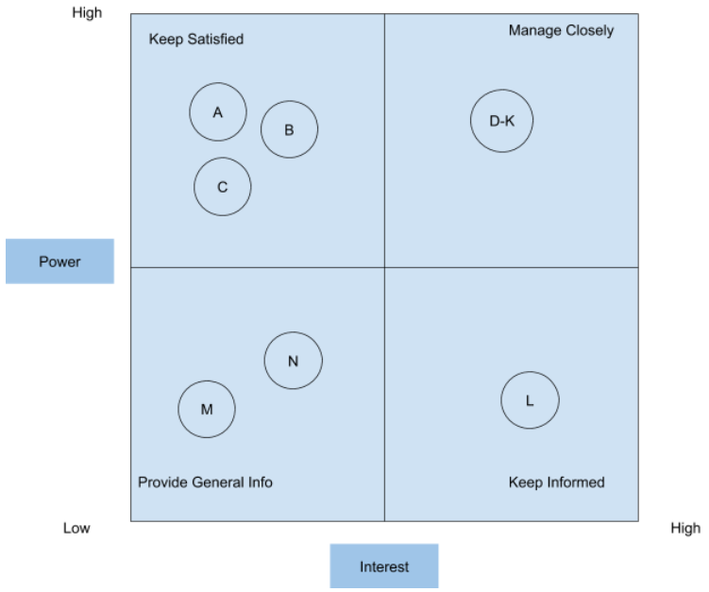

Slide 35
Governance Plan

Slide 36
Meeting | Day | Time | Input | Structure | Output | Owner | Participants
Client Interviews | Monday-Friday (until all clients are interviewed and requirements have been gathered) | Any time the client is available within business hours | Requirement Doc Draft | Each interview is conducted by a Requirements engineer who asks questions to the client to get more insight on what the client needs from the final product. | Revised Req Doc Meeting record | Requirements Engineers | Project clients
Internal Team Standup | Monday - Friday | 9:30-10AM | Project Schedule, RAID, WBS | Current tasks that are being worked on will be discussed to provide an update on project progress and evaluate if any risks or issues have occurred. Each standup is performed within a functional unit and led by the functional unit team lead. | Updated Project Schedule, Updated RAID, Updated WBS, Meeting Record | Development, Test, and Design Leads | Engineers from all project functional units (Front-end, Back-end, Requirements and Deployment), Test engineers, Designers
Project Leads Status Meeting | Friday | 10-11AM | Project Schedule, RAID | Review project progress. The Project Manager will lead these meetings. Each functional unit lead will provide a status update on project progress and make aware of any roadblocks or issues that have surfaced. Project Manager will assist in scheduling and hosting inter-functional unit discussions on assessing risks. | Updated Project Schedule, Updated RAID, Meeting Record, Status report | Project Manager | All project functional unit leads

Slide 37
Meeting | Day | Time | Input | Structure | Output | Owner | Participants
Internal Progress Demo Meeting | Friday (Bi-Weekly) | 2-3PM | Working Code, Requirements Document | Demo project core functions, achievements, and challenges faced | Progress Report, Meeting record | Development, Test, and Design Leads | Engineers (Front End, Back End, Requirements, and Deployment), Testers, Designers
Mid-Level Stakeholder Demo | Friday (Monthly) | 2-3PM | Project Dashboard, Project Schedule | Only items on the agenda will be discussed. Change Requests will be handled at the end of the meeting. Schedule follow-up to discuss any changes or issues found during the meeting. | Updated project schedule, Meeting record | Project Manager, Engineering, Test, and Design Leads | Dallas AutoParts LLC & Desired Solutions Leadership Team
Internal Story/Tasks Scheduling | Monday, Tuesday, Wednesday (Every 3 months) | 9AM-5PM | Project Schedule, RAID, WBS | Functional unit leads and Project Manager will establish a schedule for the upcoming 3 months based on team size, size of tasks, and days off. | Updated Project schedule, Updated RAID, Updated WBS, Meeting record | Project Manager | Engineering, Test, and Design Leads (functional unit leads)

Slide 38
Meeting | Day | Time | Input | Structure | Output | Owner | Participants
High-Level Stakeholder Update | Friday (Quarterly) | 12-1PM | Project Dashboard, Project Schedule | Project Manager recaps progress with clients and discusses project direction. | Updated Project schedule, Meeting record | Project Manager | Desired Solutions Leadership Team, Auto Parts Vendors & Manufacturers, Change Management Team Lead, Risk Assessment Team Lead, Third-party shipment companies, & Auto accessory companies
Deployment Meetings | Friday (Bi-Weekly), during Deployment Phase | 10-11AM | Working Code, Requirements Document | Chance for the internal engineering team to interface with external service providers so that any blockers/conflicts can be addressed, and task items assigned. Meeting will be facilitated by the engineering lead. | Meeting record | Engineering Lead | AutoParts.com, Server Provider, & Deployment Engineers
Tasks assignment meeting | Hold when project change request has been approved | TBD | WBS, Change Request Template, Project Schedule, RAID | Every employee works on new assigned tasks | Updated WBS, Signed change request doc, Updated Project schedule, Updated RAID | Project Manager | Engineers (Front End, Back End, Requirements, and Deployment), Testers, Designers

Slide 39
Communication Plan

Slide 40
What | When | Target Audience | How | Why | Owner
Milestone Report | Bi-monthly | Desired Solutions Leadership Team & Dallas AutoParts LLC | Email, Send out copy of project dashboard,Online meeting | Marks part of the official transition between SDLC milestones and involves the project manager typing a summary of what was delivered as a part of a milestone, what went well, and what could have gone better, & any possible resources needed from senior management | Project Manager
Change Request | When change request is agreed upon course of action after a meeting | Project Manager | Email, Fill out change request form as specified in Change Management Plan | Need an organized procedure to perform change request, help with project record and plan change | As decided upon at meeting
Change Notification | When appropriate (change request accepted) | Desired Solutions Leadership Team & Team Leads | Email, Send out summary of completed change request | Keep clients and manager teams on the same page, wait for manager teams to make change on project plan | As decided upon at meeting
Issue Notification | When appropriate (issue to report) | Project Manager and/or Team | Email, Send out completed issue notification | Submit issue notification to manager teams and clients, wait for their decision | Team lead or Stakeholder with issue
Escalation Meeting | When appropriate (issue being escalated) | Stakeholders involved in escalation | Online meeting | Discuss issue that has been escalated with relevant stakeholders in the room until agreement on proper course of action is reached | Project Manager

Slide 41
What | When | Target Audience | How | Why | Owner
Website Publish Notification | After public deployment complete | All customers, stakeholders and local business partner | Emails, call in | Announce Autoparts.com is online and explain general usage | Project Manager
Status Report | Weekly | Project Manager | Email and send out a JIRA Report | Keep track of project schedule, cost and to monitor any changes or risks encountered. | Developer Lead, Test team lead, Design Lead (functional unit leads)
Risk Assessment Notification | When a risk is identified and has impact level = high | Project Manager | Email, send out complete Risk Assessment template | Bring active risks to team leads and PM's attention, so that can meet up with the team leads to formulate action plan | Team leads
Technical Discussion | When facing technique difficulty | Team lead & Project manager | Email, online meeting | Solve the issue as soon as possible to avoid delaying project progress | Developers
Client Interview | When we need to get project requirements | Requirements Engineers & project clients | Email, online meetings, call | To understand what the clients need from the final product developed and to gather the requirements for the project. | Requirements Engineers

Slide 42
Lessons Learned

